Slide 1
Sea Math Test 2
Questions

Slide 2


Slide 3
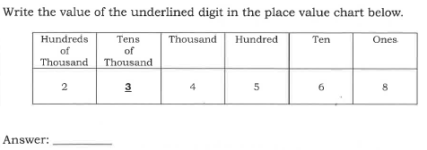
Question 1

Slide 4

Question 2

Slide 5
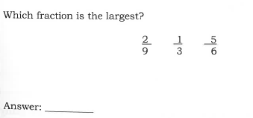
Question 3

Slide 6

Question 4

Slide 7

Question 5

Slide 8
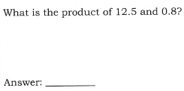
Question 6

Slide 9
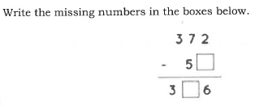
Question 7

Slide 10
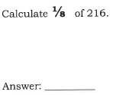
Question 8

Slide 11

Question 9

Slide 12
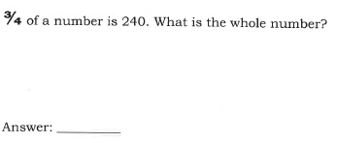
Question 10

Slide 13
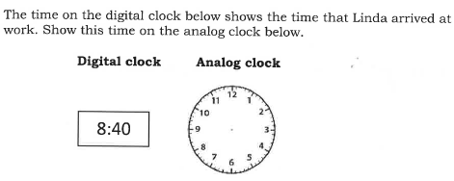
Question 11

Slide 14
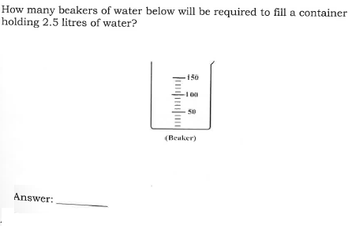
Question 12

Slide 15
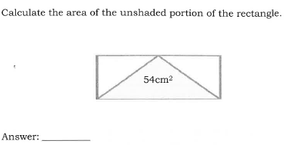
Question 13

Slide 16

Question 14

Slide 17
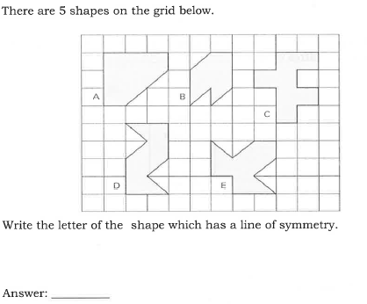
Question 15

Slide 18
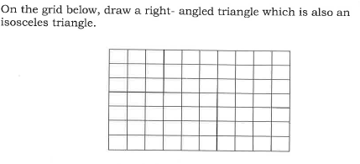
Question 16

Slide 19
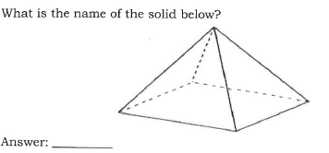
Question 17

Slide 20
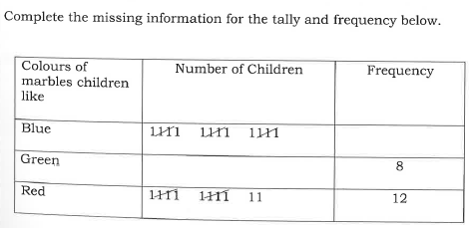
Question 18

Slide 21
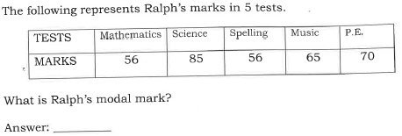
Question 19

Slide 22
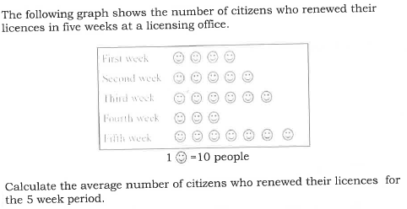
Question 20

Slide 23

Question 21

Slide 24
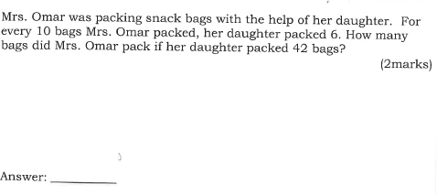
Question 22

Slide 25
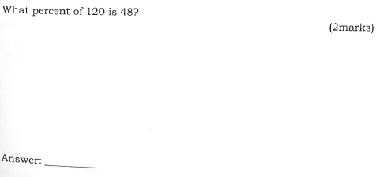
Question 23

Slide 26
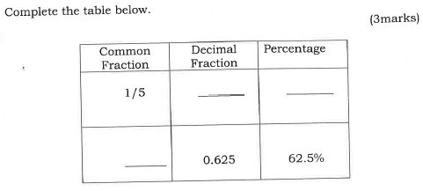
Question 24

Slide 27
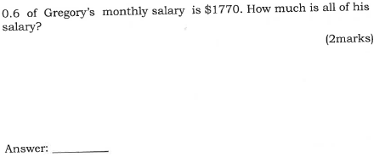
Question 25

Slide 28
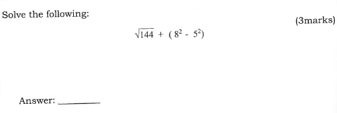
Question 26

Slide 29
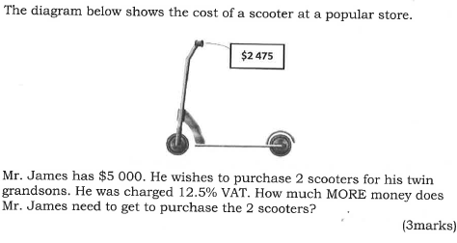
Question 27

Slide 30
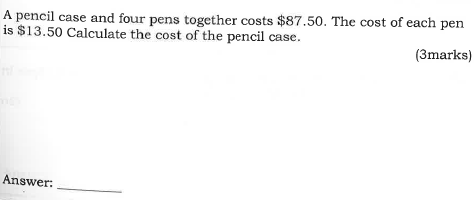
Question 28

Slide 31

Question 29

Slide 32
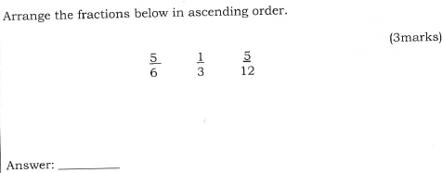
Question 30

Slide 33

Question 31

Slide 34

Question 32

Slide 35
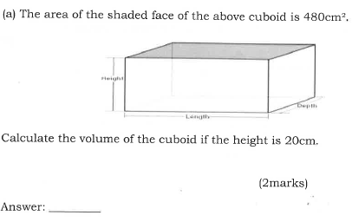
Question 33

Slide 36
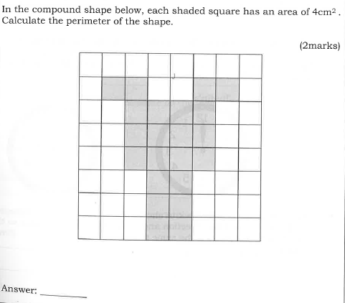
Question 34

Slide 37
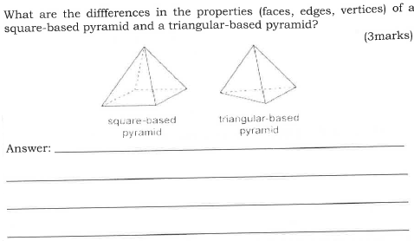
Question 35

Slide 38
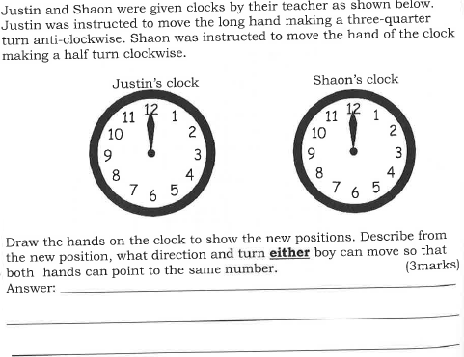
Question 36

Slide 39
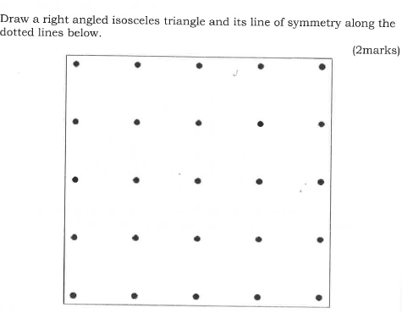
Question 37

Slide 40

Question 38

Slide 41

Question 39

Slide 42
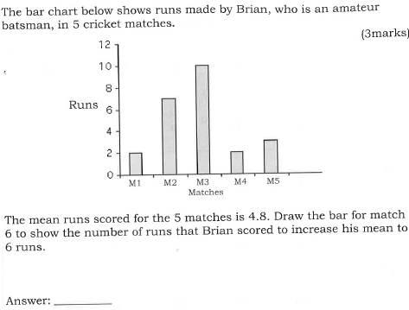
Question 40

Slide 43
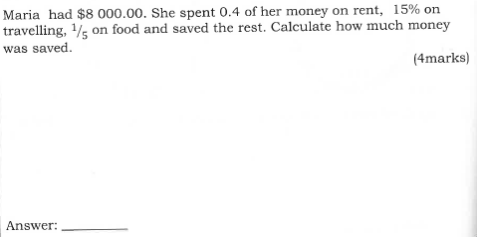
Question 41

Slide 44

Question 42

Slide 45
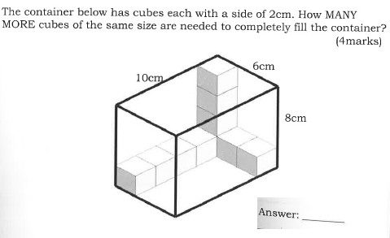
Question 43

Slide 46
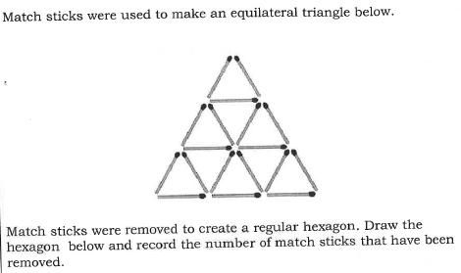
Question 44

Slide 47
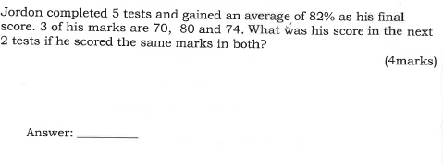
Question 45

