Slide 1
Mathematics
Test 1 - Answers

Slide 2
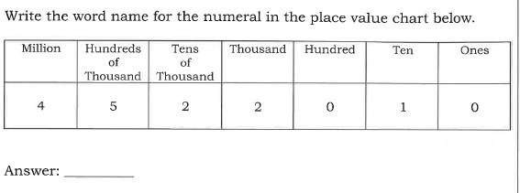
Answer1
Four million five hundred and twenty-two thousand and ten

Slide 3
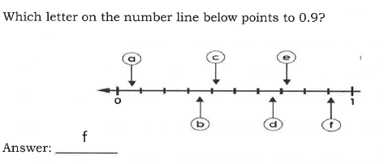
Answer 2

Slide 4

Answer 4

Slide 5
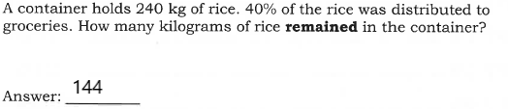
Answer 4

Slide 6



Working for Question 4
Total rice = 240kg
Method 1 = 40% distributed
40% is 40 out of every 100 (or )
= x = 4 x 24 = 96 kg. Therefore 96kg was distributed.
How many remained = 240 – 96 = 144kg
Method 2 = 100 – 40 = 60% remains, therefore
= x = 6 x 24 = 144
Ans = 144

Slide 7
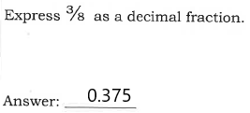

Answer 5
3/8 =

Slide 8
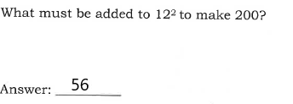
Answer 6

Slide 9
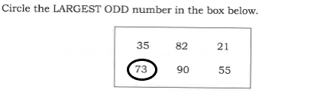
Answer 7

Slide 10
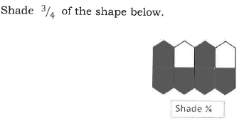
Answer 8

Slide 11
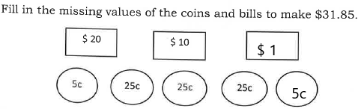
Answer 9

Slide 12
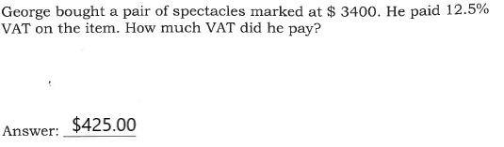
Answer 10

Slide 13
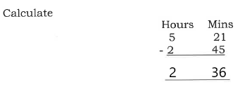
Answer 11

Slide 14
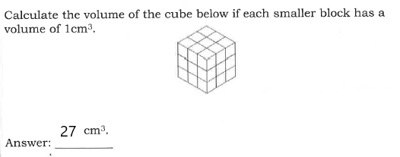
Answer 12

Slide 15
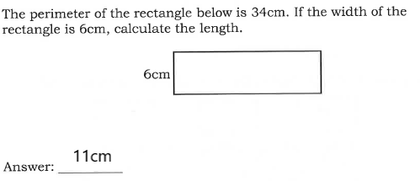
Answer 13

Slide 16

Answer 14

Slide 17
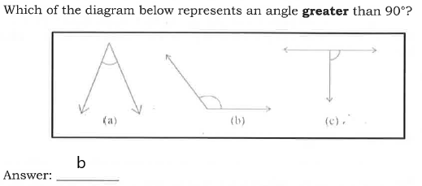
Answer 15

Slide 18
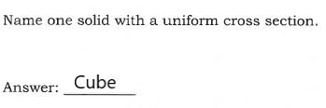
Answer 16

Slide 19
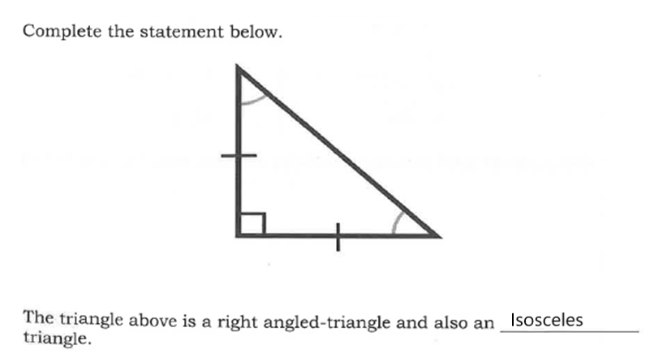
Answer 17

Slide 20

Answer 18

Slide 21
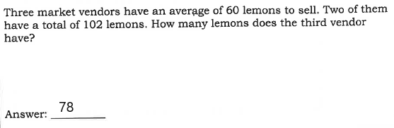
Answer 19

Slide 22
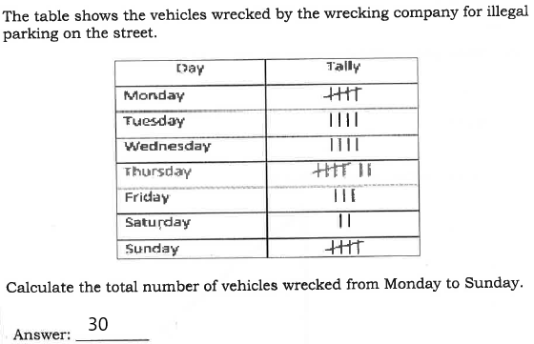
Answer 20

Slide 23
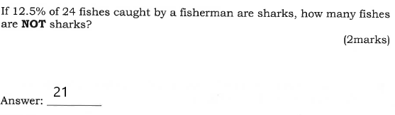
Answer 21

Slide 24
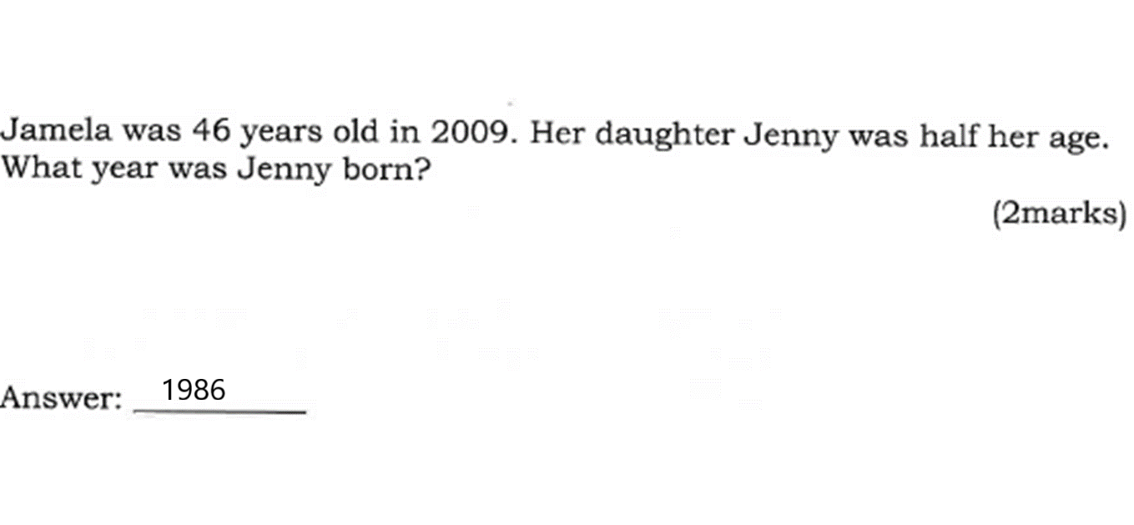
Answer 22

Slide 25
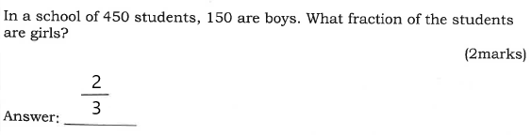
Answer 23

Slide 26
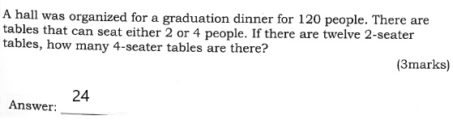
Answer 24

Slide 27
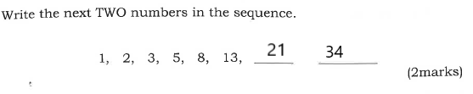
Answer 25

Slide 28
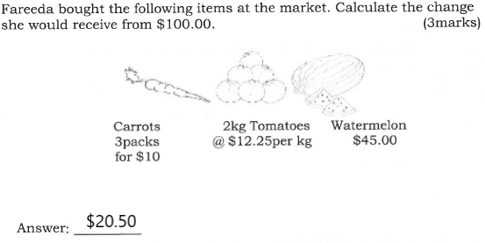
Answer 26

Slide 29
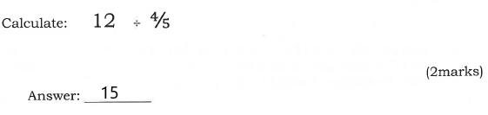
Answer 27

Slide 30
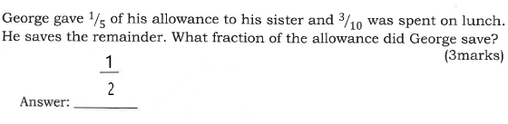
Answer 28

Slide 31
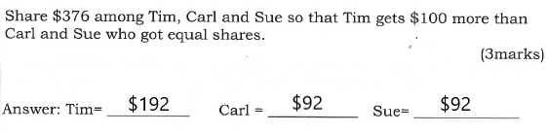
Answer 29

Slide 32
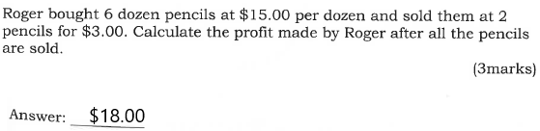
Answer 30

Slide 33
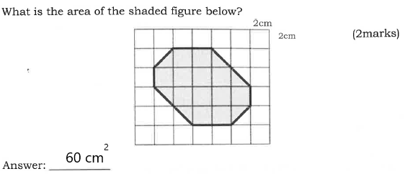
Answer 31

Slide 34
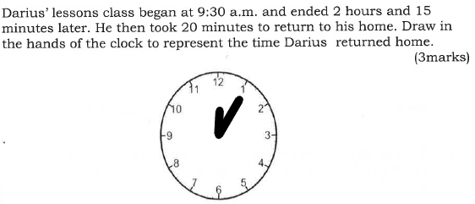
Answer 32

Slide 35
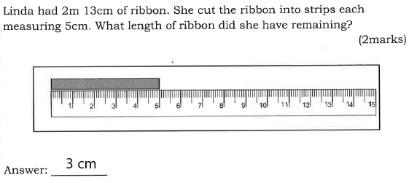
Answer 33

Slide 36
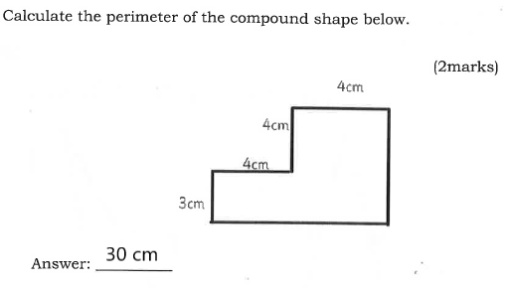
Answer 34

Slide 37
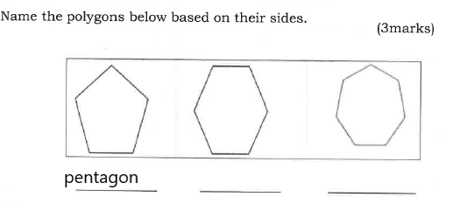
Answer 35

Slide 38
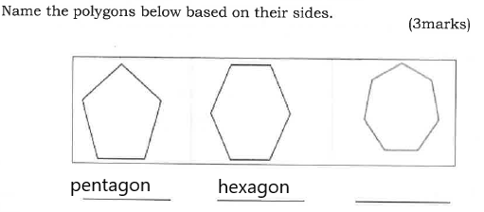
Answer 35

Slide 39
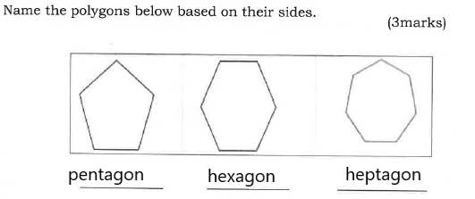
Answer 35

Slide 40
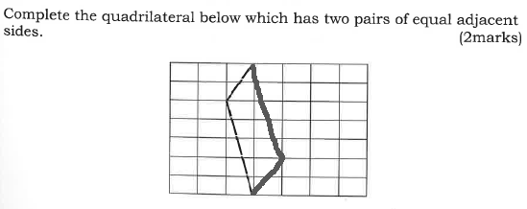
Answer 36

Slide 41
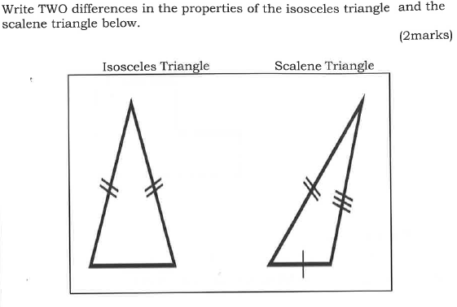
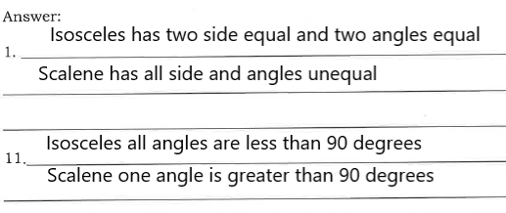
Answer 37

Slide 42
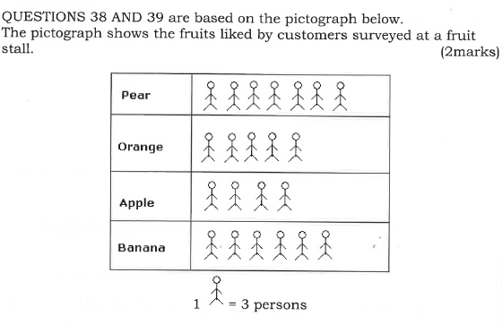

Answer 38

Slide 43
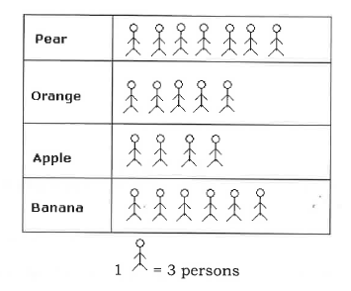
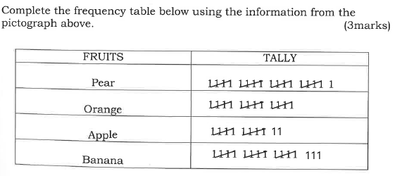
Answer 39

Slide 44
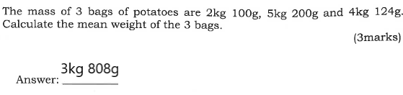
Answer 40

Slide 45
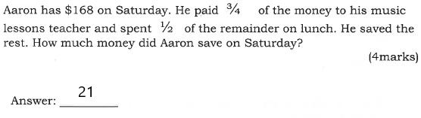
Answer 41

Slide 46
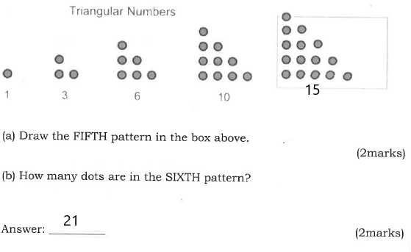
Answer 42

Slide 47
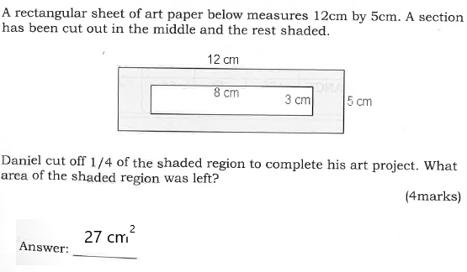
Answer 43

Slide 48
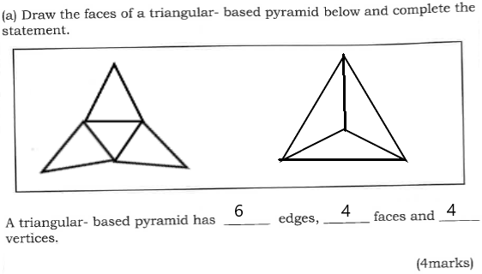
Answer 44

Slide 49
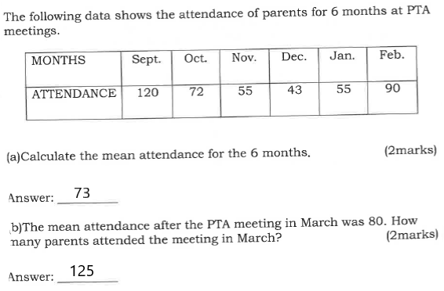
Answer 45

